Slide 1




Effect of layered approach on certification of HIV testing sites per the WHO SPI-RT checklist:
Lesson learned from Tanzania.
Presenter: Yohanes Msigwa
Date: June 6, 2024

Slide 2
Presentation outline
Introduction
Methodology
Results
Conclusion
Recommendations

Slide 3
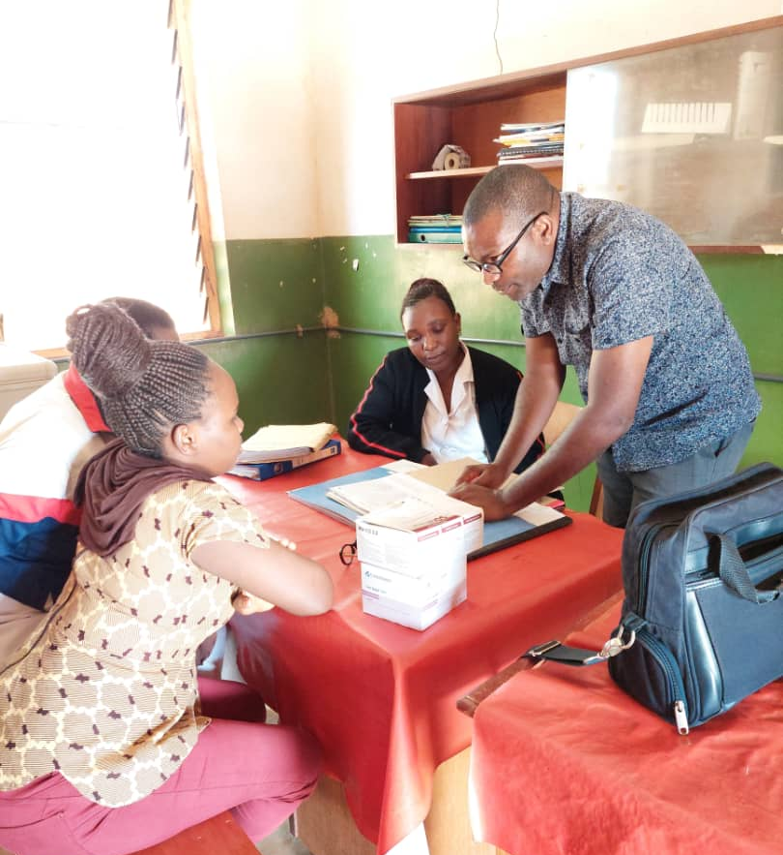
Introduction
Tanzania developed the “National Framework for POCT certification 2017” which guided the implementation of the quality initiative (QI) on HIV-RT Sites
Despite the roll-out of the framework, Tanzania remained with less than 5% of certified HIV-RT Sites, 4 years post-inception of this framework
Development of layered approach for HIV-RT site certification as game changer

Slide 4
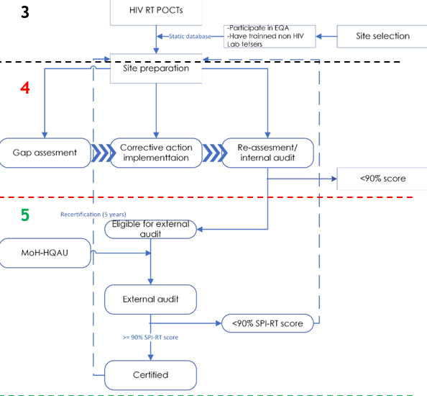
Methodology
From 2022 - 2023 we developed sites selection model
Selection of the sites was based on
  Participation in HIV–EQA schemes
  Not being certified in the last two years
Enrolled Sites into certification were subjected to two phases:
  1. Site preparation
  Gap assessment
  Mentorship
  Internal Audit
  2. External audit
National Certification and Licensing Process for HIV POCTs

Slide 5
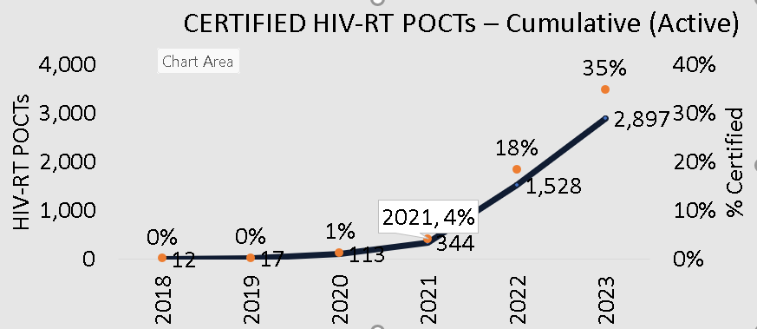
Results of layered approach on certification of HIV testing sites
By end of 2023, 5,747 (8,307) HIV RT sites were eligible for internal audit
5,329 sites (93%) were eligible for external audit
Only 2,843 (53%) were certification
Certification coverage increased from 2% to 35%, marking a 17.5-fold rise compared to previous years
HIV-RT certification coverage and incremental gains before and after implementation of gap assessment, mentorship and audit layered approach
Timeframe | Internal Audit | Recommended for external audit | Externally audited | Certified HIV-RT POCTs | % certified | Yearly contributions
2018 | 147 | 18 | 18 | 18 | 100% | 1%
2019 | 1,017 | 391 | 0 | 0 | 0% | 0%
2020 | 3,908 | 746 | 746 | 130 | 17% | 5%
2021 | 2,958 | 489 | 489 | 50 | 10% | 2%
2022 | 3,750 | 2,254 | 2,227 | 1,276 | 57% | 45%
2023 | 2,120 | 1,849 | 1,849 | 1,369 | 74% | 48%
HIV-RT certification coverage trends from 2020 to 2023

Slide 6


Conclusion
LESSON: Implementation of an approach that combined gap assessment, mentorship, and audit activities to enhance HIV-RT sites’ readiness for certification has proved to be a potential model that can increase yield in the certification of HIV-RT sites in Tanzania
PLAN
Expanding and strengthening the layered approach to certify more sites especially at this point of limited resources
Integrate HIV RT sites certification program into the Annual facility budget as a sustainability plan
Expand the use of Peers in HIVST distribution and share best practices with the government for consideration to formalize Youth Peers as part of Differentiated Services Delivery model
that peer delivered and facilitated community-based HIV self-test distribution is feasible and effective method for HIVST services and promotion

Slide 7
Acknowledgment
PEPFAR
CDC HQ and Tanzania
World Health Organization (WHO)
Management Development for Health (MDH)
Regional Clinical IPs

Slide 8
Thank you ( Asanteni sana!)

